Slide 1
Classification

Slide 2
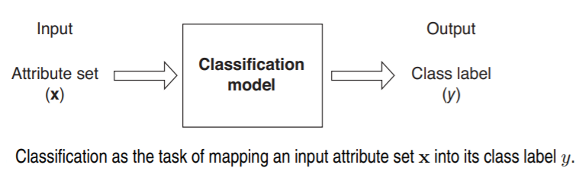
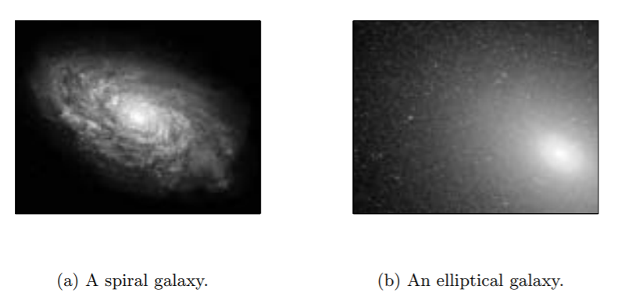
Classification problem

Slide 3
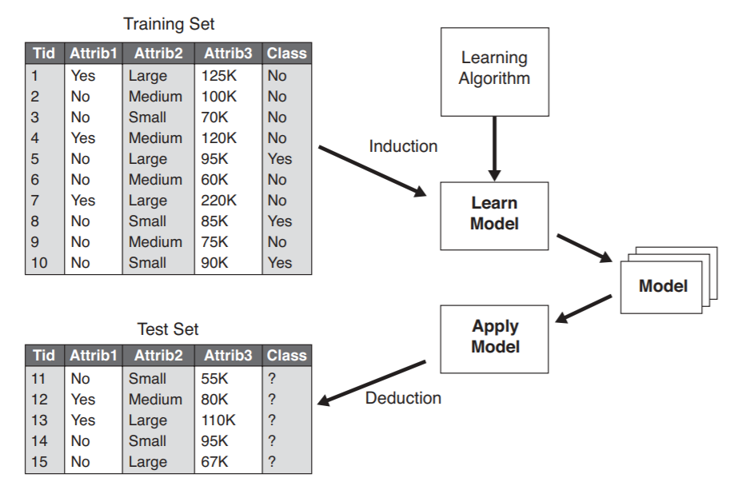
General approach for building classification model

Slide 4
History of classification algorithm
Pre 1980
Linear decision boundary
1980s
Efficient learning of non linear decision boundaries (c4.5, ANN)
Suffering from local minima
1990s
Computational Learning theory for non linear decision boundaries was developed

Slide 5
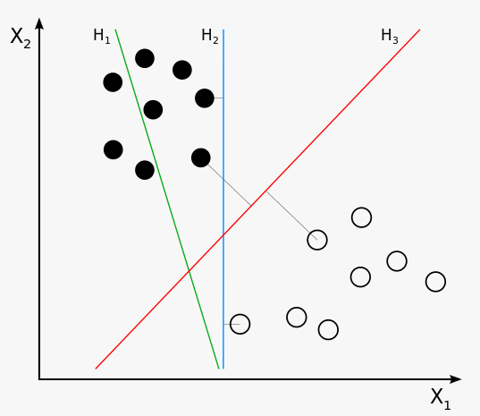
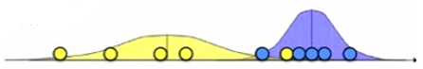
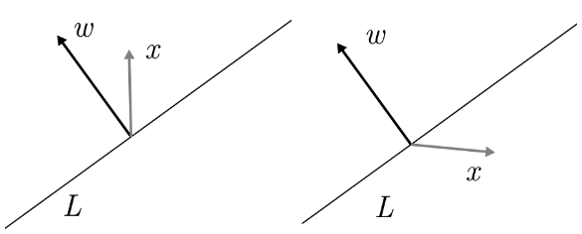
Classification problem
Dot product & Cosine rule
=> Decision boundary

Slide 6
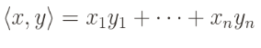
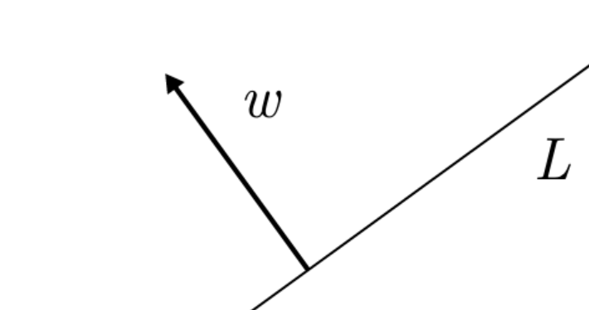
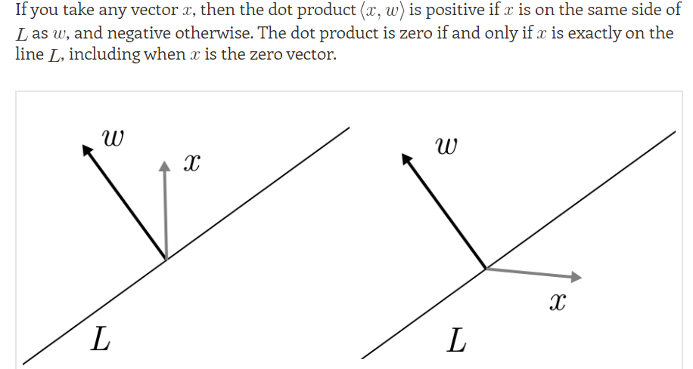
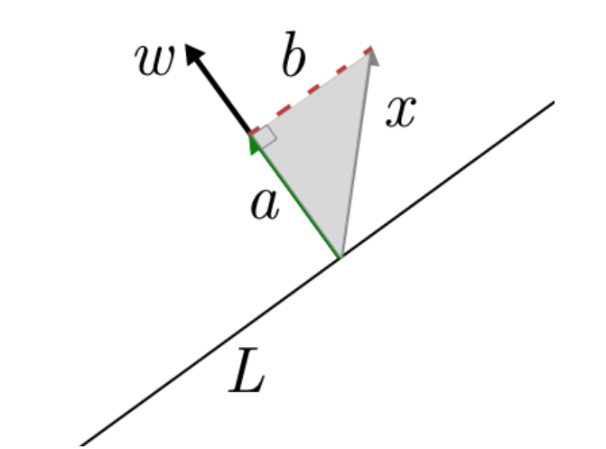
Inner product as a decision rule
Inner product is defined by the formula
If we have a line L passing through the origin and w being a unit vector perpendicular to it

Slide 7
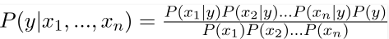
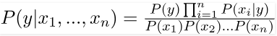
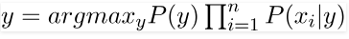
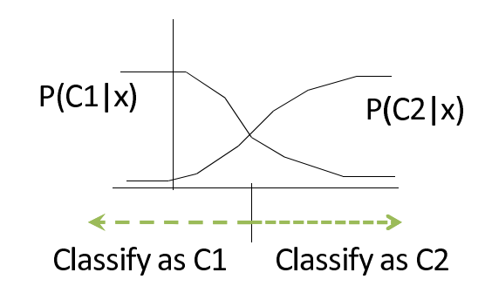
Naïve Bayes Algorithm (First Cut Model)
Features are independent – Assumption
We need a classifier model – find the probability of a given set of inputs for all possible values of the class
So finally we are left with the task

Slide 8
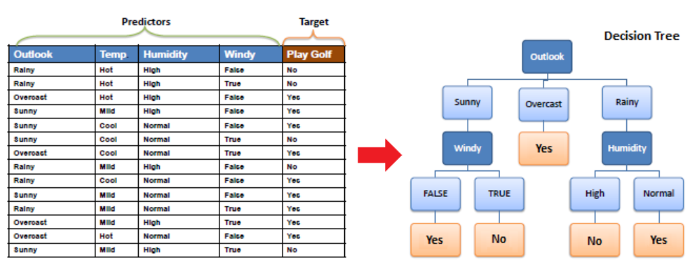
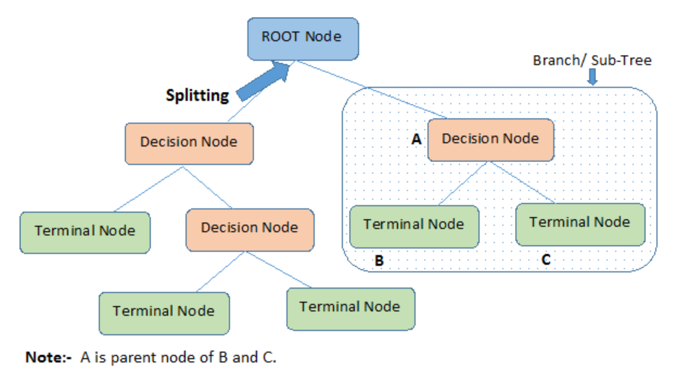
Decision trees
Algorithms used in decision trees
ID3, C4.5, Gini index, Chi-square, reduction in variance

Slide 9
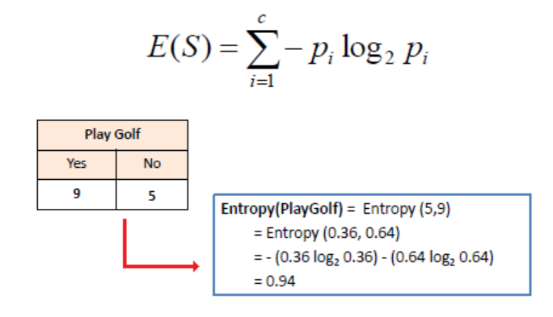
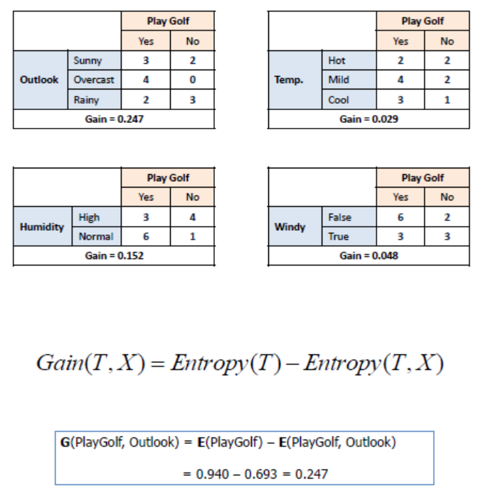
ID3
Entropy using frequency table of one attribute
Calculate information gain

Slide 10
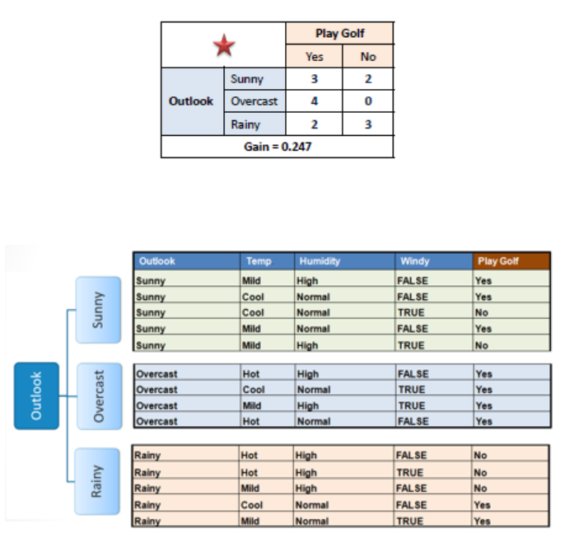
Contd..
Choose attribute with largest information gain

Slide 11
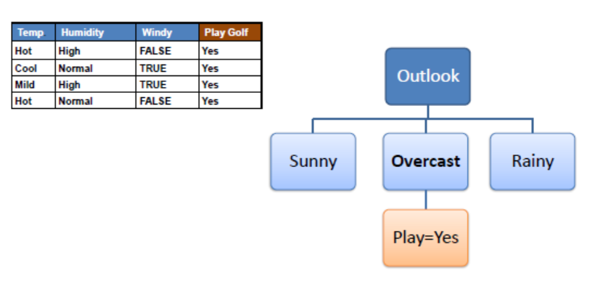
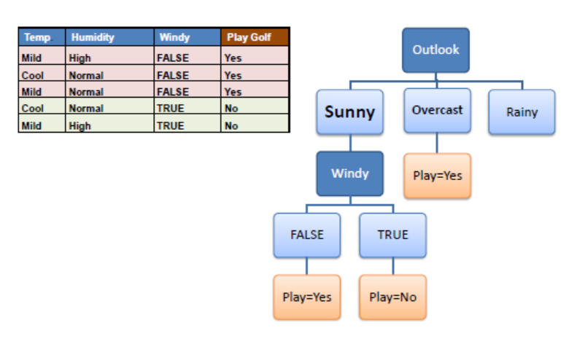
Contd..
A branch with entropy 0 is a leaf node
A branch with entropy more than 0 will need further splitting

Slide 12
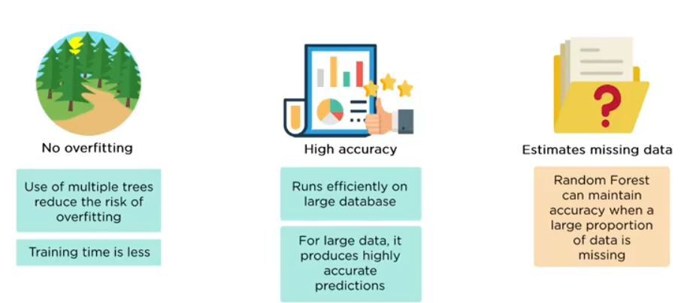
Why Random forest

Slide 13
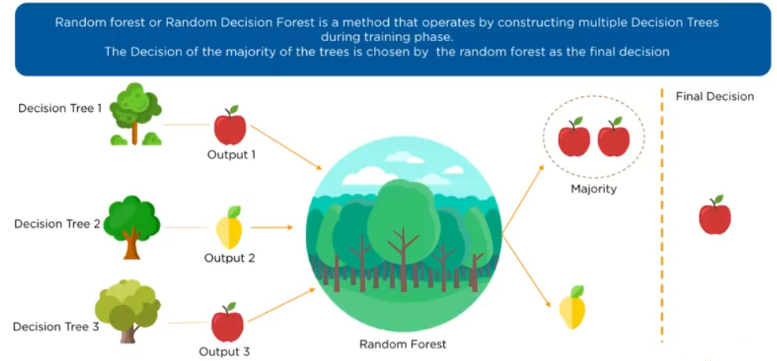
What is random forest

Slide 14
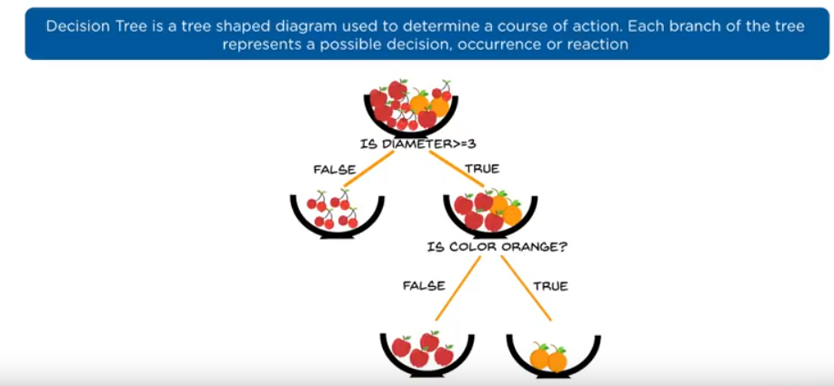
A single decision tree

Slide 15
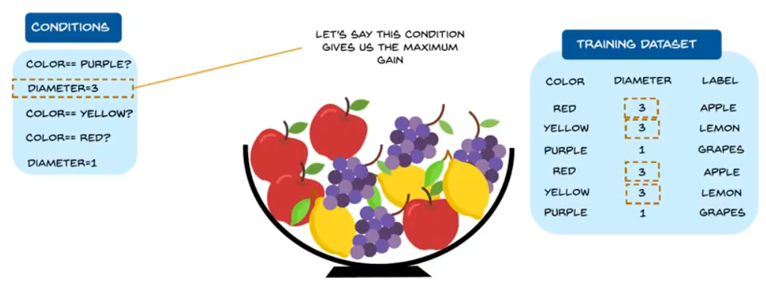
example

Slide 16
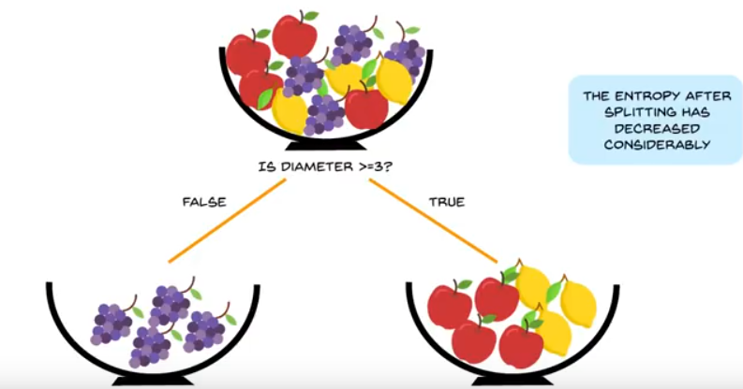
Contd..

Slide 17
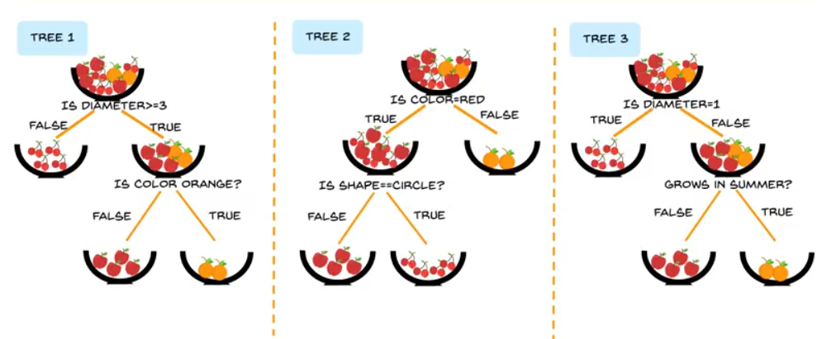
Contd..

Slide 18
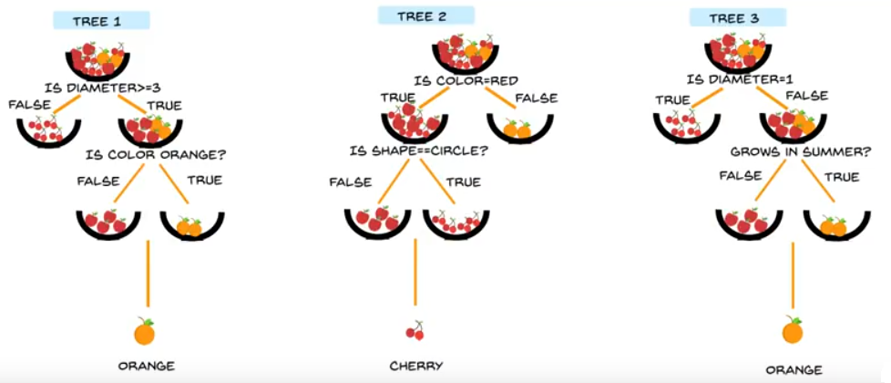
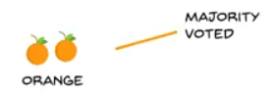
Contd..

Slide 19
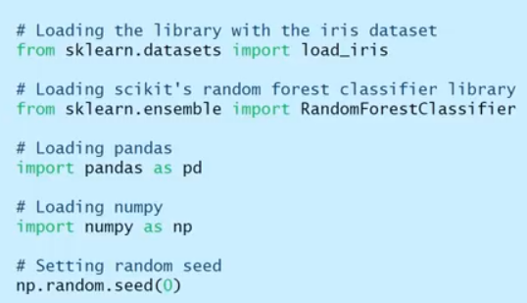
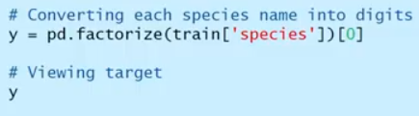
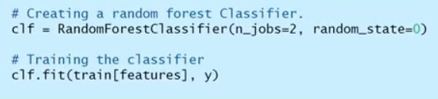
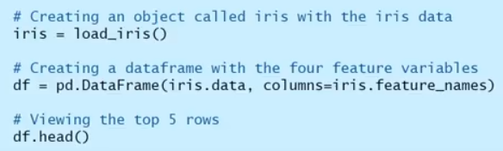
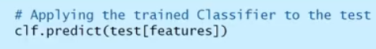
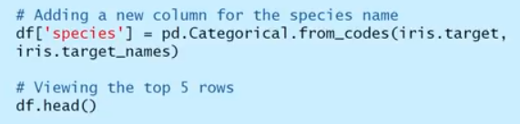
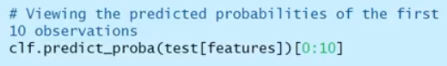
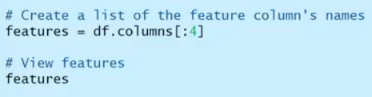
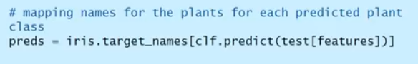
Implementation

Slide 20
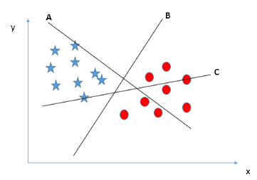
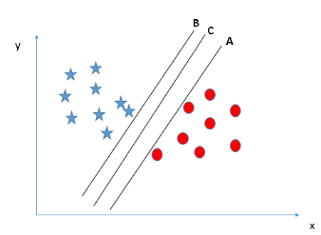
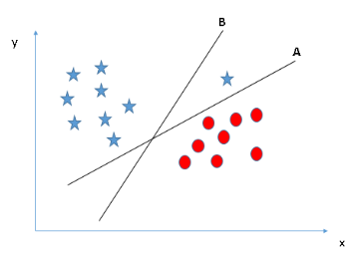
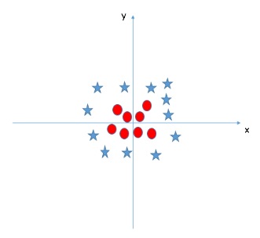
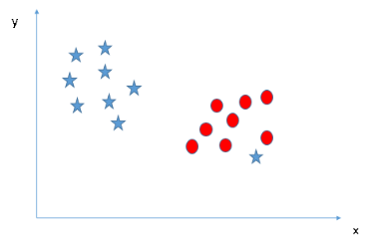
Examples of decision boundaries
We need to address 2 issues
Maximizing the margin
Convert non linear decision boundary to linear one

Slide 21
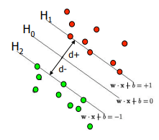
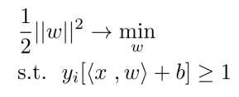
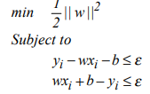
Maximizing the margin
Support vectors are the data points closest to the decision surface
w is the vector whose linear combination predicts y
Hyper plane h1 and h2 passes through their respective support vectors
Ho is the hyperplane we need to find that maximizes both d+ and d-
To find d+ take any support vector(x0, y0), if the general eqn of the hyperplane
Is Ax + By + c = 0, then distance is |Ax0+By0+c|/sqrt(A^2+B^2)
Using the above, d+ + d- = 2/||w||^2
It is an optimization problem
For regression type problem the optimization problem can be written as

Slide 22
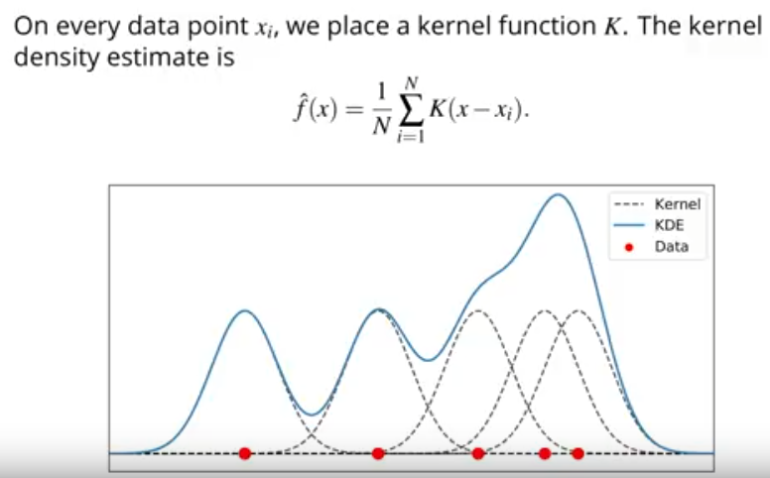
Kernel density estimate

Slide 23
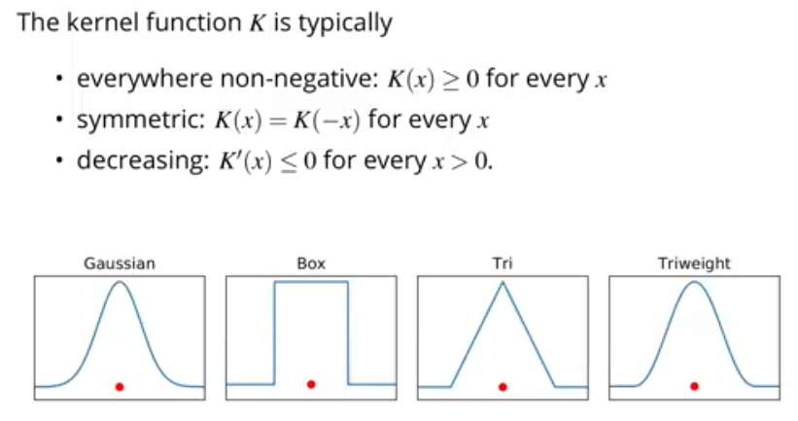
Choice of kernels

Slide 24
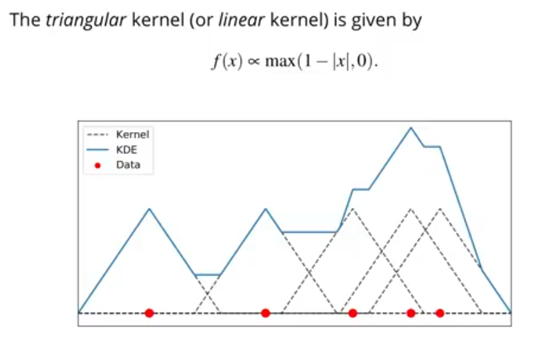
Example of fitting a triangular kernel

Slide 25
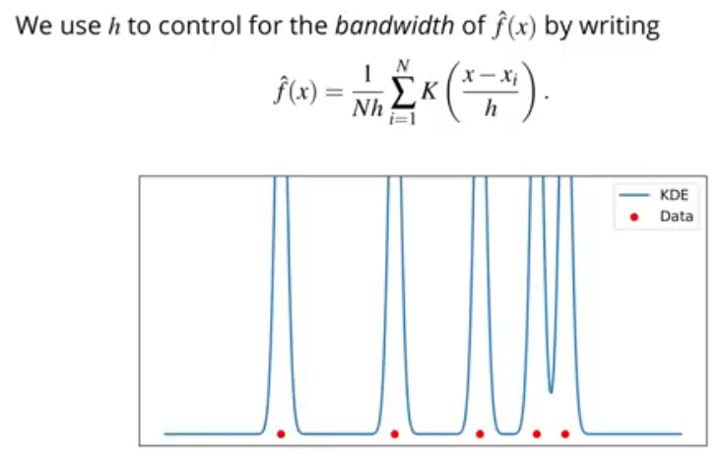

Choice of bandwidth

Slide 26

Improved Sheather Jones algorithm
Helps if the data is multimodal
Better than silverman

Slide 27



Kernelization
How do we solve the linear case?
In non-linear case?

Slide 28

Contd..

Slide 29

Kernel matrix

Slide 30

Kernel function
When data has a curved shape, we need transformation from lower dimension to higher dimension – this function is called kernel function
The kernel function enables a linear decision boundary in higher dimension

Slide 31





Understanding kernel in more details
Example 1
Example 2
For higher dimension

Slide 32


Contd..
Kernel as higher dimensional feature mapping
Consider two training example
K implicitly defines the mapping to higher dimension
K also computes the dot product
We only needed to define k in certain way

Slide 33



Contd..

Slide 34
Now SVM in a nutshell
The objective of the SVM is to create a hyperplane in a N-1 dimensional space (N = number of features) to classify data points distinctly
Out of many possible hyperplane we need to find the plane with maximum margin
SVM problem is a constrained minimization problem that use lagrange multiplier
To find the widest road between different samples we just need to consider dot products of support vectors and the samples
When we cannot linearly separable dataset we apply kernel tricks
The idea is mapping the non-linear seperable data into higher dimensional space so that we can find a hyperplane (linear)

Slide 35



Gaussian classifier – 1D

Slide 36




Slide 37






